Slide 1




RKMVERI
ENERGIO : ARCHITECTURAL BLAZE IN ENERGY INSIGHT
A MACHINE LEARNING PERSPECTIVE
DEBAJYOTI MAITY – ANIRBAN DEY
B2230023 B2230019

Slide 2


CONTENT
01
02
03
04
05
Introduction
SOP
Objective
EDA
Modelling
06
07
08
09
Evaluation
Challenges
Future Work
Conclusion

Slide 3




INTRODUCTION
Reduce energy consumption
Mitigate environmental impact, and enhance sustainability.
Optimize energy usage
Reduce environmental degradation

Slide 4





PROBLEM STATEMENT
Addressing high energy consumption, the aim is to identify key factors influencing energy consumption by analyzing the relationship between building characteristics and heating/cooling loads.
This guides the implementation of energy-efficient building practices for cost-effectiveness and sustainability.
Optimization
Cost-effectiveness
Sustainability
GOALS
Guideline
Quantification
BENEFITS
ENERGY USAGE OPTIMIZATION
COST EFFECTIVE BUINDINGS
REDUCE ENVIRONMENTAL DEGRADATION
ENHANCED SUSTAINABILITY

Slide 5







DATA PREP & CLEAN
Data Collection
Data Description
Collected Energy Efficiency Data from UC Irvine, Machine Learning Repository. The Data is licensed under a Creative Commons Attribution 4.0 International (CC BY 4.0) license.
The dataset contains eight attributes (or features, denoted by X1...X8) and two responses (or outcomes, denoted by y1 and y2).
Data Cleaning
Data Categorization
Eliminated rows having Null Values for several columns. But Luckly, In our data we don’t have any NULL values associated with any entries.
Categorized columns in Attributes, Discrete Variables & Continuous Variables for Analysis purpose.

Slide 6

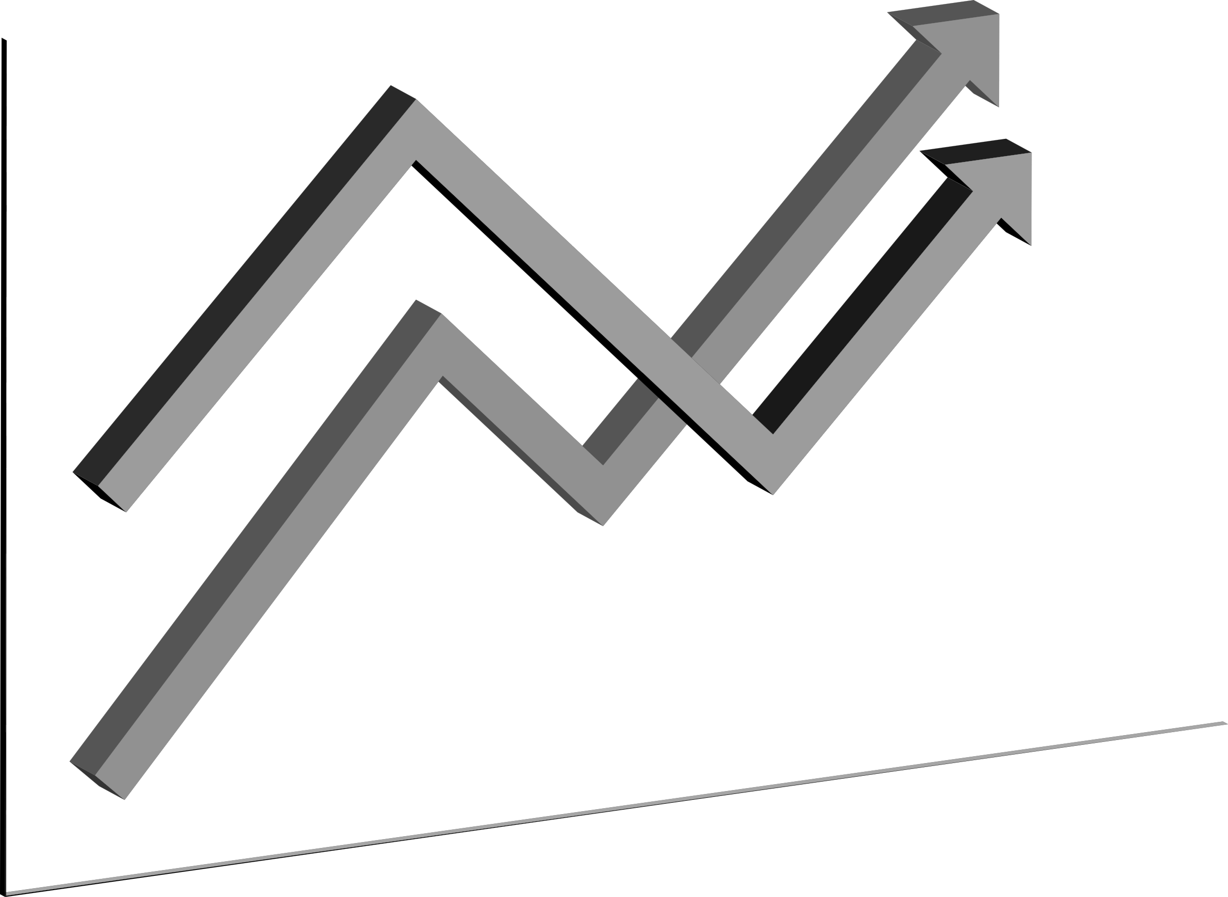
EXPLORATORY DATA ANALYSIS
In our EDA, we dive into a dataset featuring eight crucial attributes and two responses, aiming to uncover patterns influencing heating and cooling loads in buildings. From compactness to glazing area distribution, we explore key factors, paving the way for precise predictive modeling. This analysis is foundational, offering insights to inform decisions in energy-efficient and sustainable building design.

Slide 7
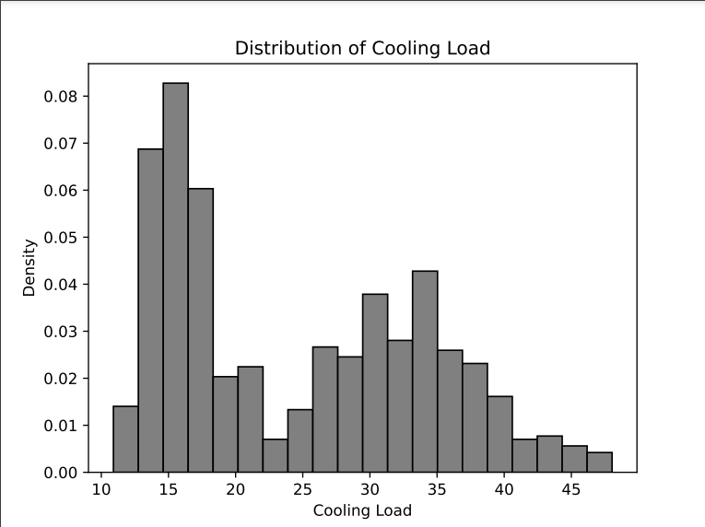
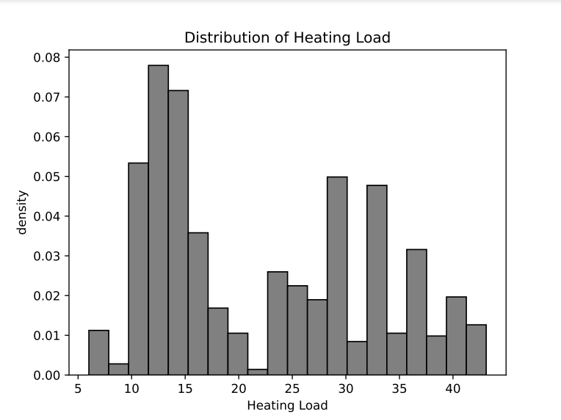

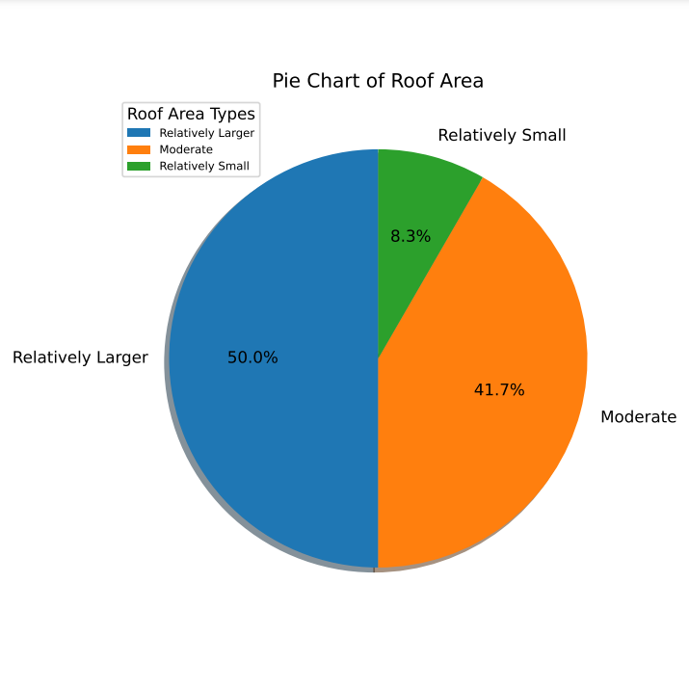

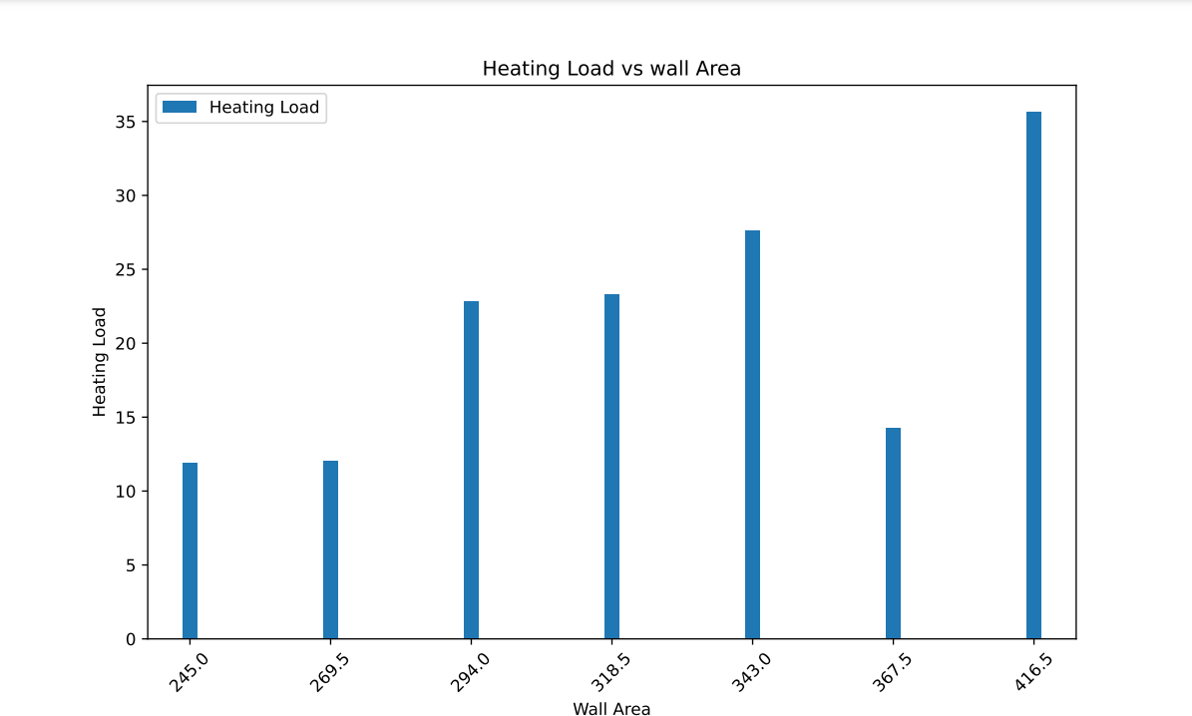
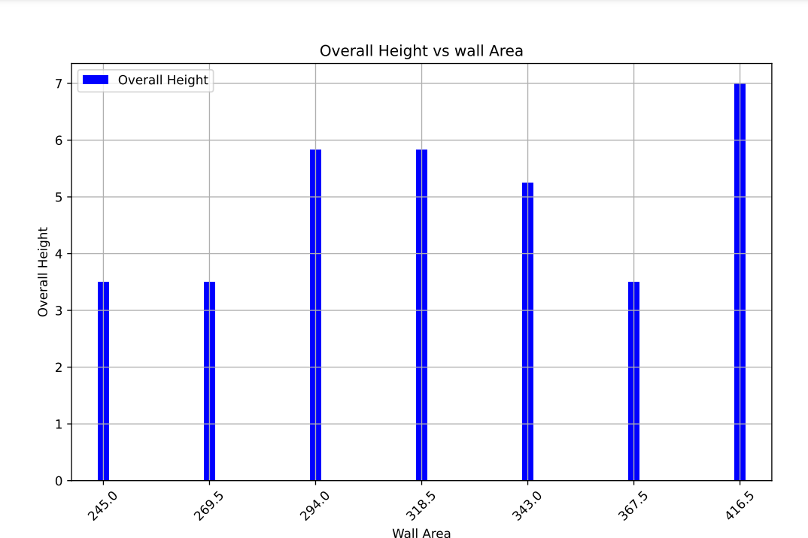

Maximum House”s Heating Load and Cooling Load lies between the interval 12 to 16
The number of Relatively larger roof area is greater than the relatively small and Moderate roof area
The customers with lower data usage, higher monthly charges & lower total charges have a higher churn rate.
From these plot we conclude that The Building”s whose wall area are 367.5 but the heating load be less, because when the wall area is 367.5 but the height of the building is less other the building

Slide 8






Linear Regression
K- Neighborhood Regression
Linear regression assumes a linear relationship between the input features (X1 to X8) and the output responses (y1 and y2). This aligns with the idea that changes in the building characteristics will result in a proportional change in the heating and cooling loads.
Unlike linear regression, KNN is a non-parametric algorithm. It does not assume a specific functional form for the relationship between the features and the target variables. This flexibility makes it suitable for capturing complex patterns in the data. KNN makes predictions by considering the k-nearest data points in the feature space. For each prediction, it identifies the k-nearest neighbors based on the similarity of feature values. This allows the model to provide localized predictions that consider the characteristics of nearby data points.
MODELLING
Decision Tree Regressor
Decision Tree Regression excels in capturing non-linear relationships between features and target variables. It forms a tree-like structure where each node represents a decision based on a feature, allowing for complex mappings and The algorithm automatically selects the most relevant features for predicting the target variables, aiding in the identification of critical building attributes influencing heating and cooling loads.

Slide 9

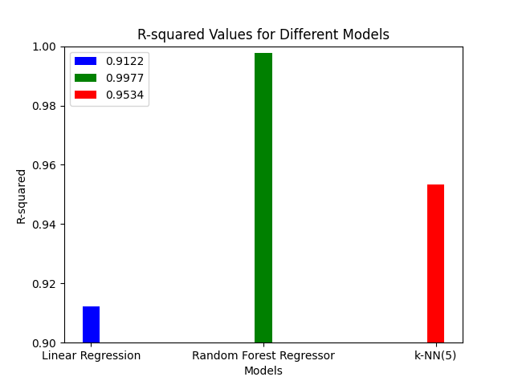
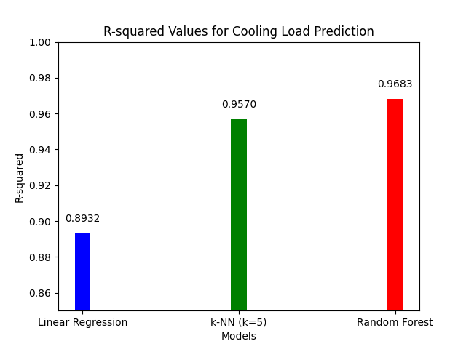
ACCURACY EVALUATION

Slide 10


CHALLENGES
Developing strategies for continual assessment and maintenance to sustain efficiency over time
Implementing cost-effective solutions suitable for specific environments.
Balancing insulation, ventilation, glazing, and orientation for energy efficiency. Achieving optimal design without compromising aesthetics and functionality.
Occupants' behavior significantly affects energy consumption. So we have to Encourage behavioral changes and promote awareness among occupants.

Slide 11
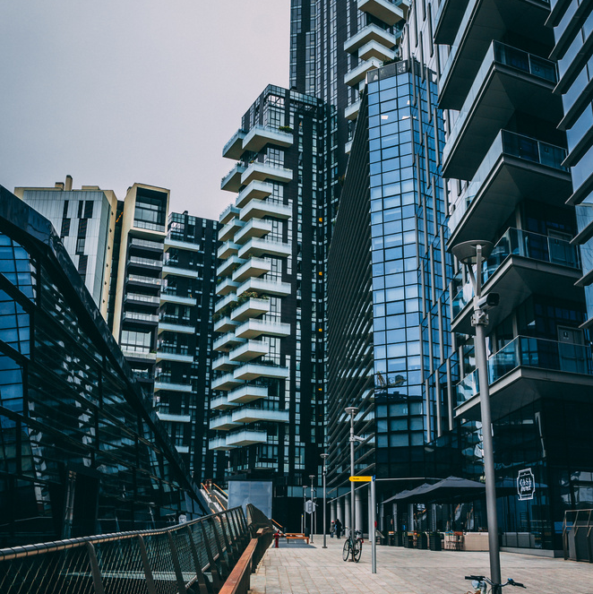


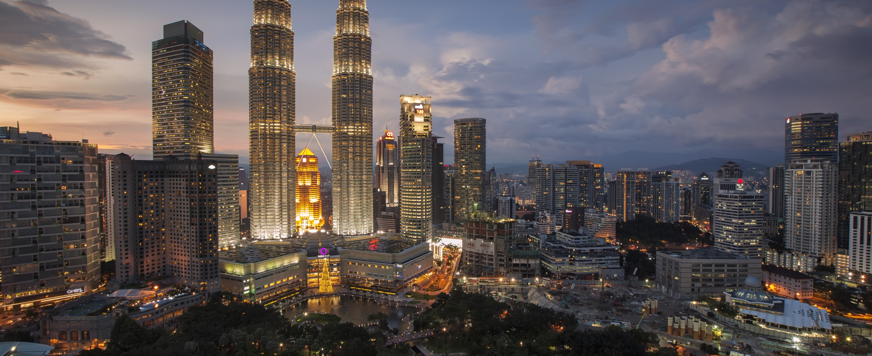
FUTURE WORK
Integrated Smart Systems
Behavioral Adaptation Strategies
Cost-Effective Retrofit Solutions
Develop and implement smart systems to optimize energy efficiency.
Research innovative strategies to influence occupants' behavior, encouraging energy-conscious habits
Investigate retrofitting solutions for older buildings, to meet modern energy standards while minimizing disruptions and costs.

Slide 12




CONCLUSION
The outcomes of this project have the potential to inform decision-making processes in architectural design, ultimately promoting environmentally conscious and economically viable solutions for enhanced sustainability and optimizing energy usage.
Empowering Decision-Making
Environmental Impact
Actionable Insights

Slide 13





OUR TEAM
Debajyoti Maity
2nd Year MSc BDA Student
RKM Vivekananda Educational & Research Institute
+91 74074 53991
in
debajyoti-maity-77172125b
Belur, Howrah
Anirban Dey
2nd Year MSc BDA Student
RKM Vivekananda Educational & Research Institute
+91 91635 68623
in
anirban-dey-26b081260
Belur, Howrah

Slide 14





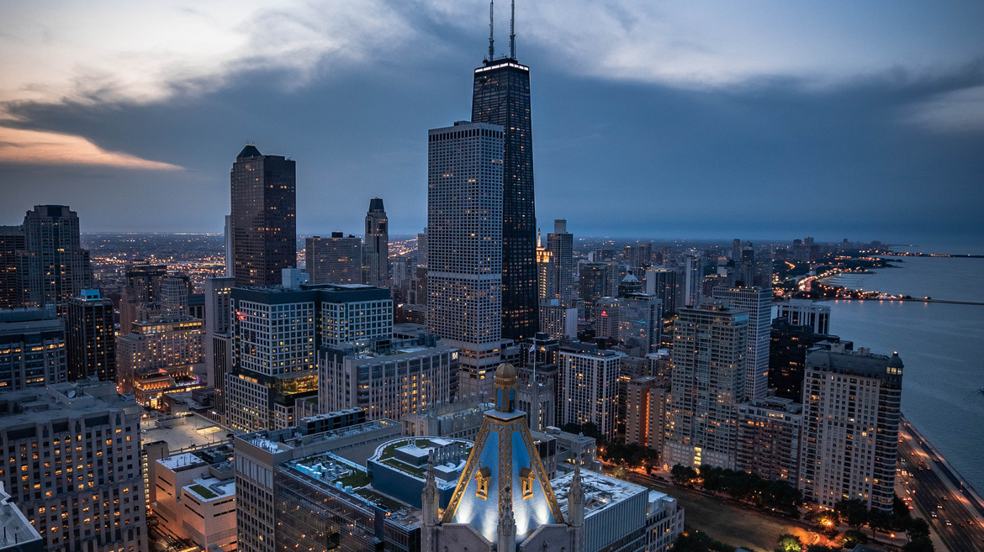

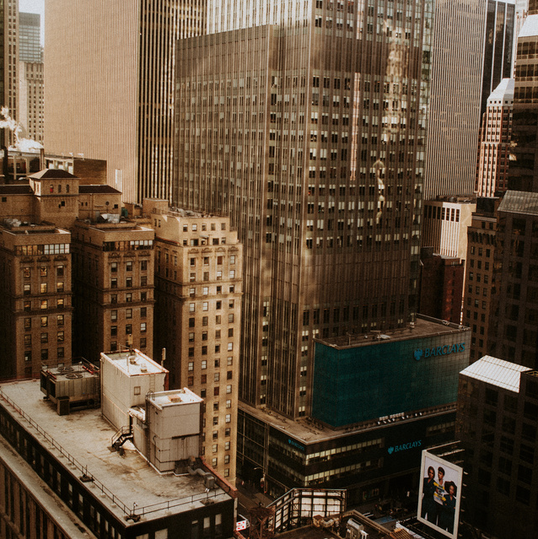

RKMVERI
THANK'S FOR WATCHING

